Slide 1
Predicting Airbnb prices in Washington D.C.
Daniel Park
danielp2@umbc.edu
DATA 606

Slide 2
Accomplishments since Delivery 2
Finished Exploratory Data Analysis
Applied XGBoost successfully to the dataset
Found the feature importance of each feature in the dataset

Slide 3
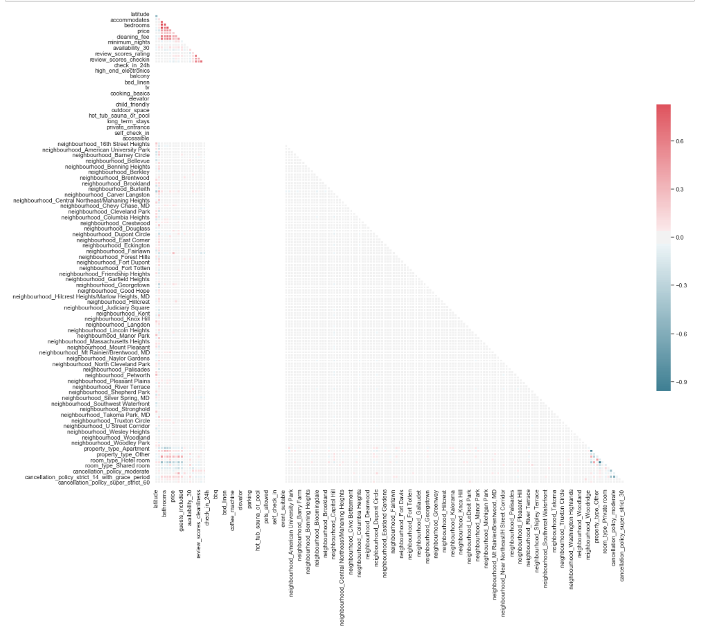
Data Exploratory Analysis

Slide 4
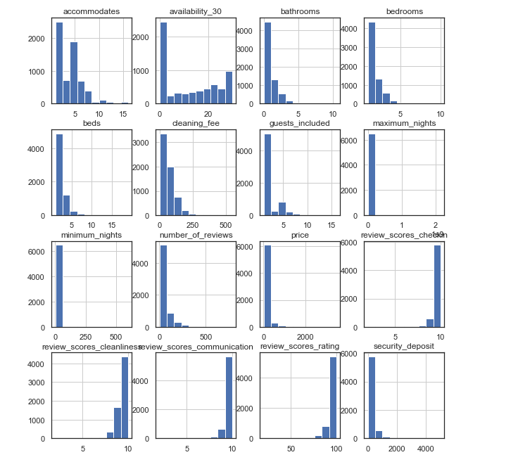
Data Exploratory Analysis

Slide 5
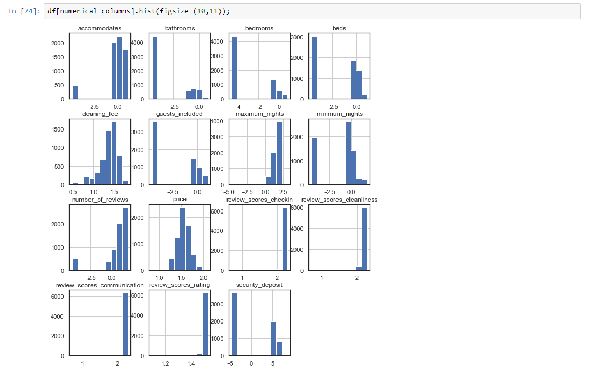
Data Exploratory Analysis

Slide 6
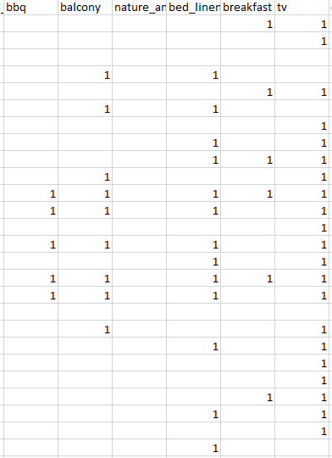
One Hot Encoding
Process that turns categorical variables into a form that ML algorithms can easily read.

Slide 7
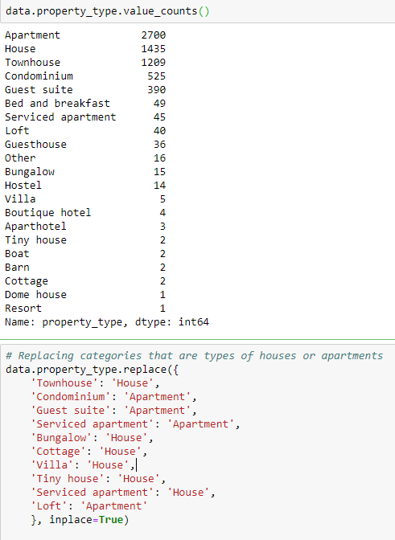
Simplifying

Slide 8
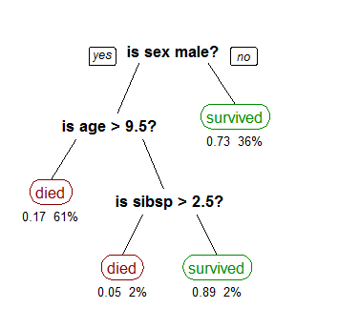
XGBoost
eXtreme Gradient Boosting
Implementation of gradient boosted decision trees meant for speed and performance
Source: https://towardsdatascience.com/decision-trees-in-machine-learning-641b9c4e8052

Slide 9
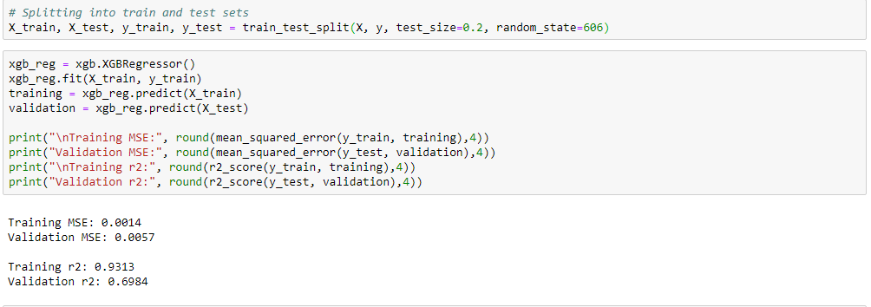
XGBoost results

Slide 10
Feature Importance
Score that shows how useful each feature was in the creation of the decision tree.
This importance is calculated explicitly for each attribute in the dataset, allowing attributes to be ranked and compared to each other.
Source: https://machinelearningmastery.com/feature-importance-and-feature-selection-with-xgboost-in-python/

Slide 11
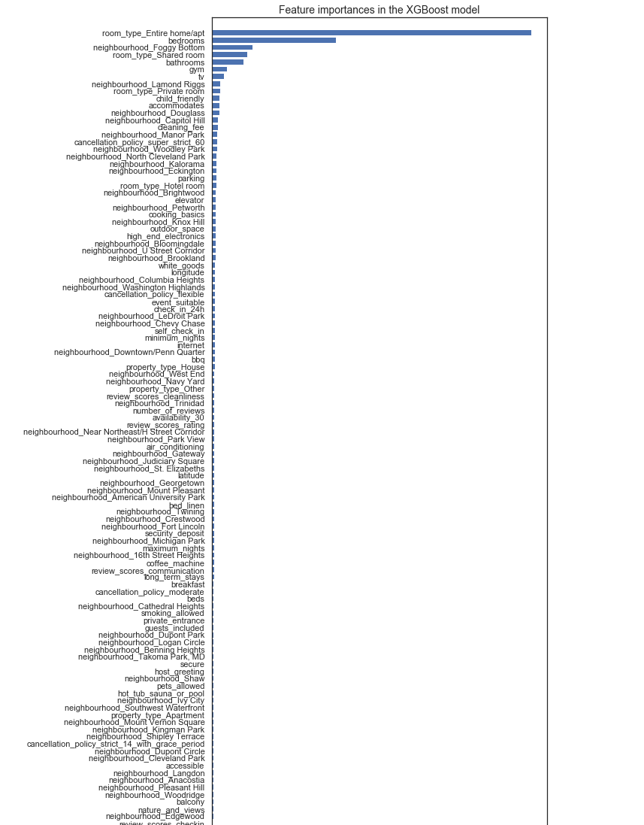
Feature Importance

Slide 12
Plans for Delivery 4
No more Hedonic Regression
Adding more neural network algorithms (haven’t decided which ones yet).

Slide 13
Questions?
danielp2@umbc.edu

